Slide 1

RMarkdown
Melinda Higgins, PhD; Research Professor – Emory University
Alex Edwards, Research Informatics Analyst – Emory University

Slide 2
Rstudio cloud
https://rstudio.cloud/
https://rstudio.cloud/spaces/36397/join?access_code=sVkAKq5o45zIeUMI2EhDJps3PgY5NF28X5UELrOf

Slide 3
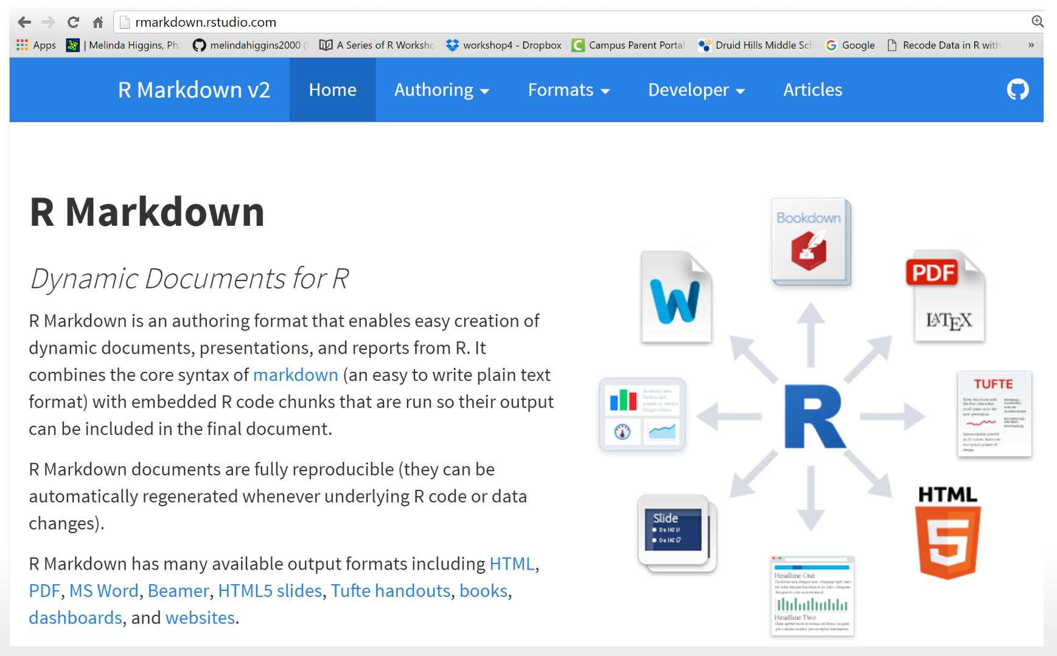
https://rmarkdown.rstudio.com/

Slide 4
Outline
Simple R script
Rmarkdown document
Rmarkdown Slides
Rmarkdown with custom parameters
Rmarkdown Dashboard

Slide 5
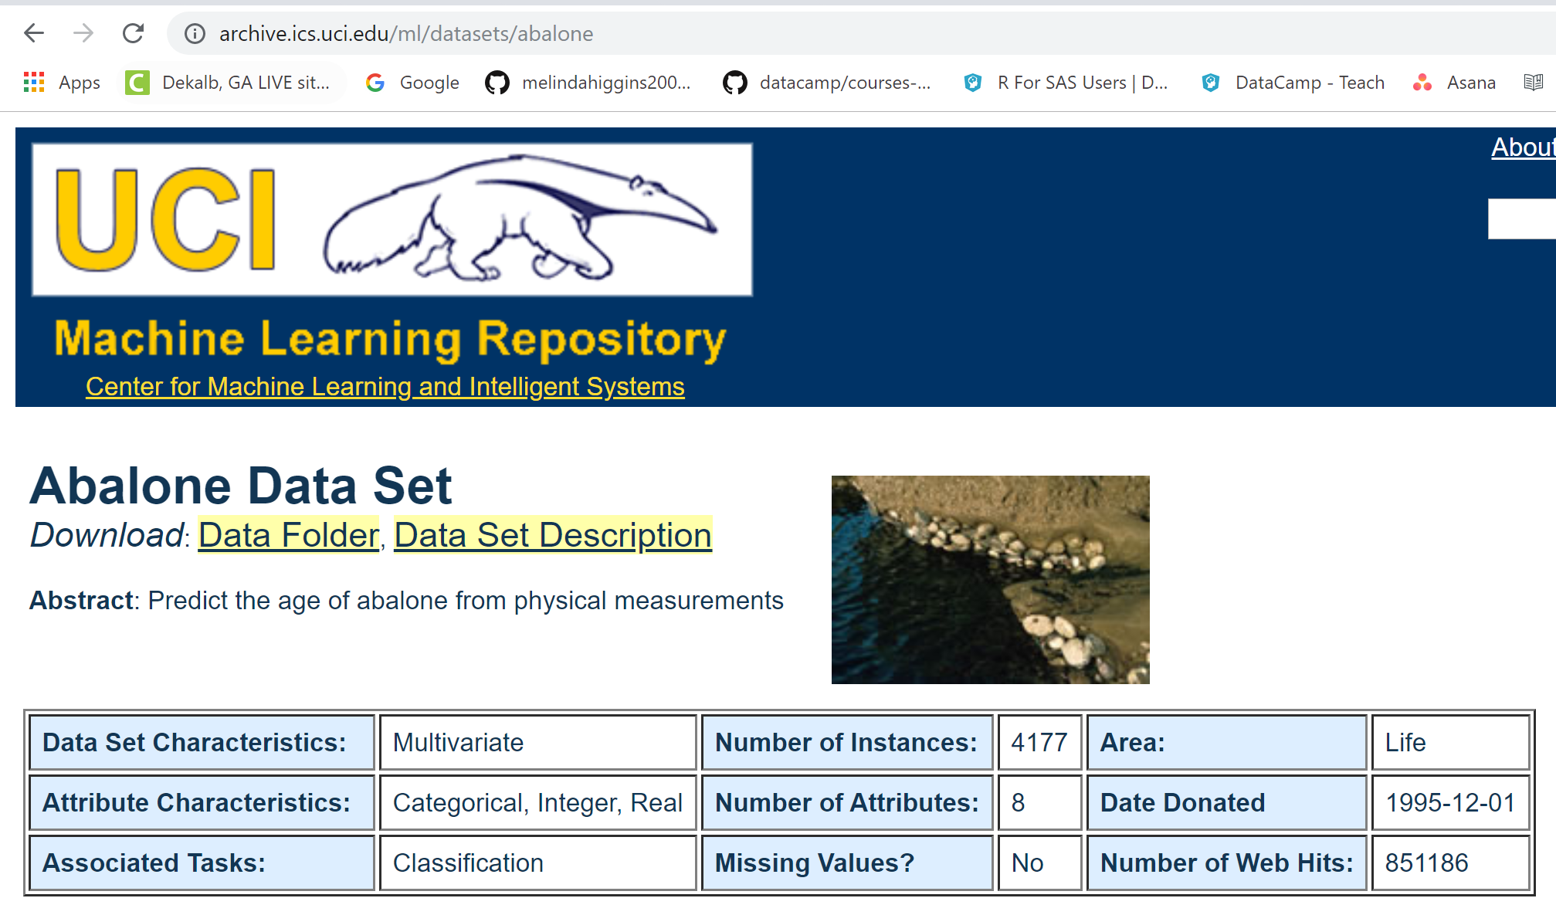
https://archive.ics.uci.edu/ml/datasets/abalone

Slide 6
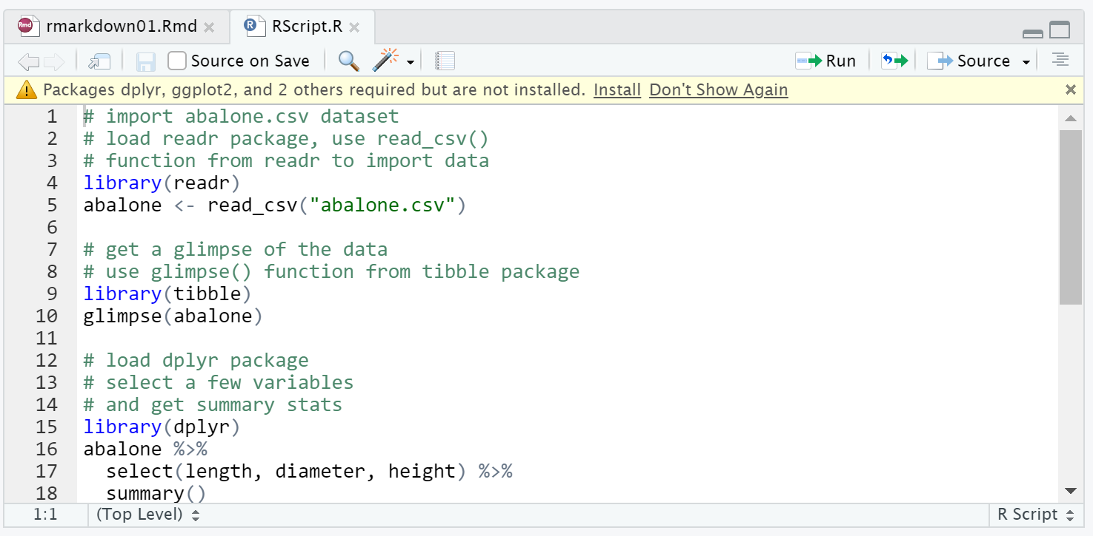
Rscript.r

Slide 7
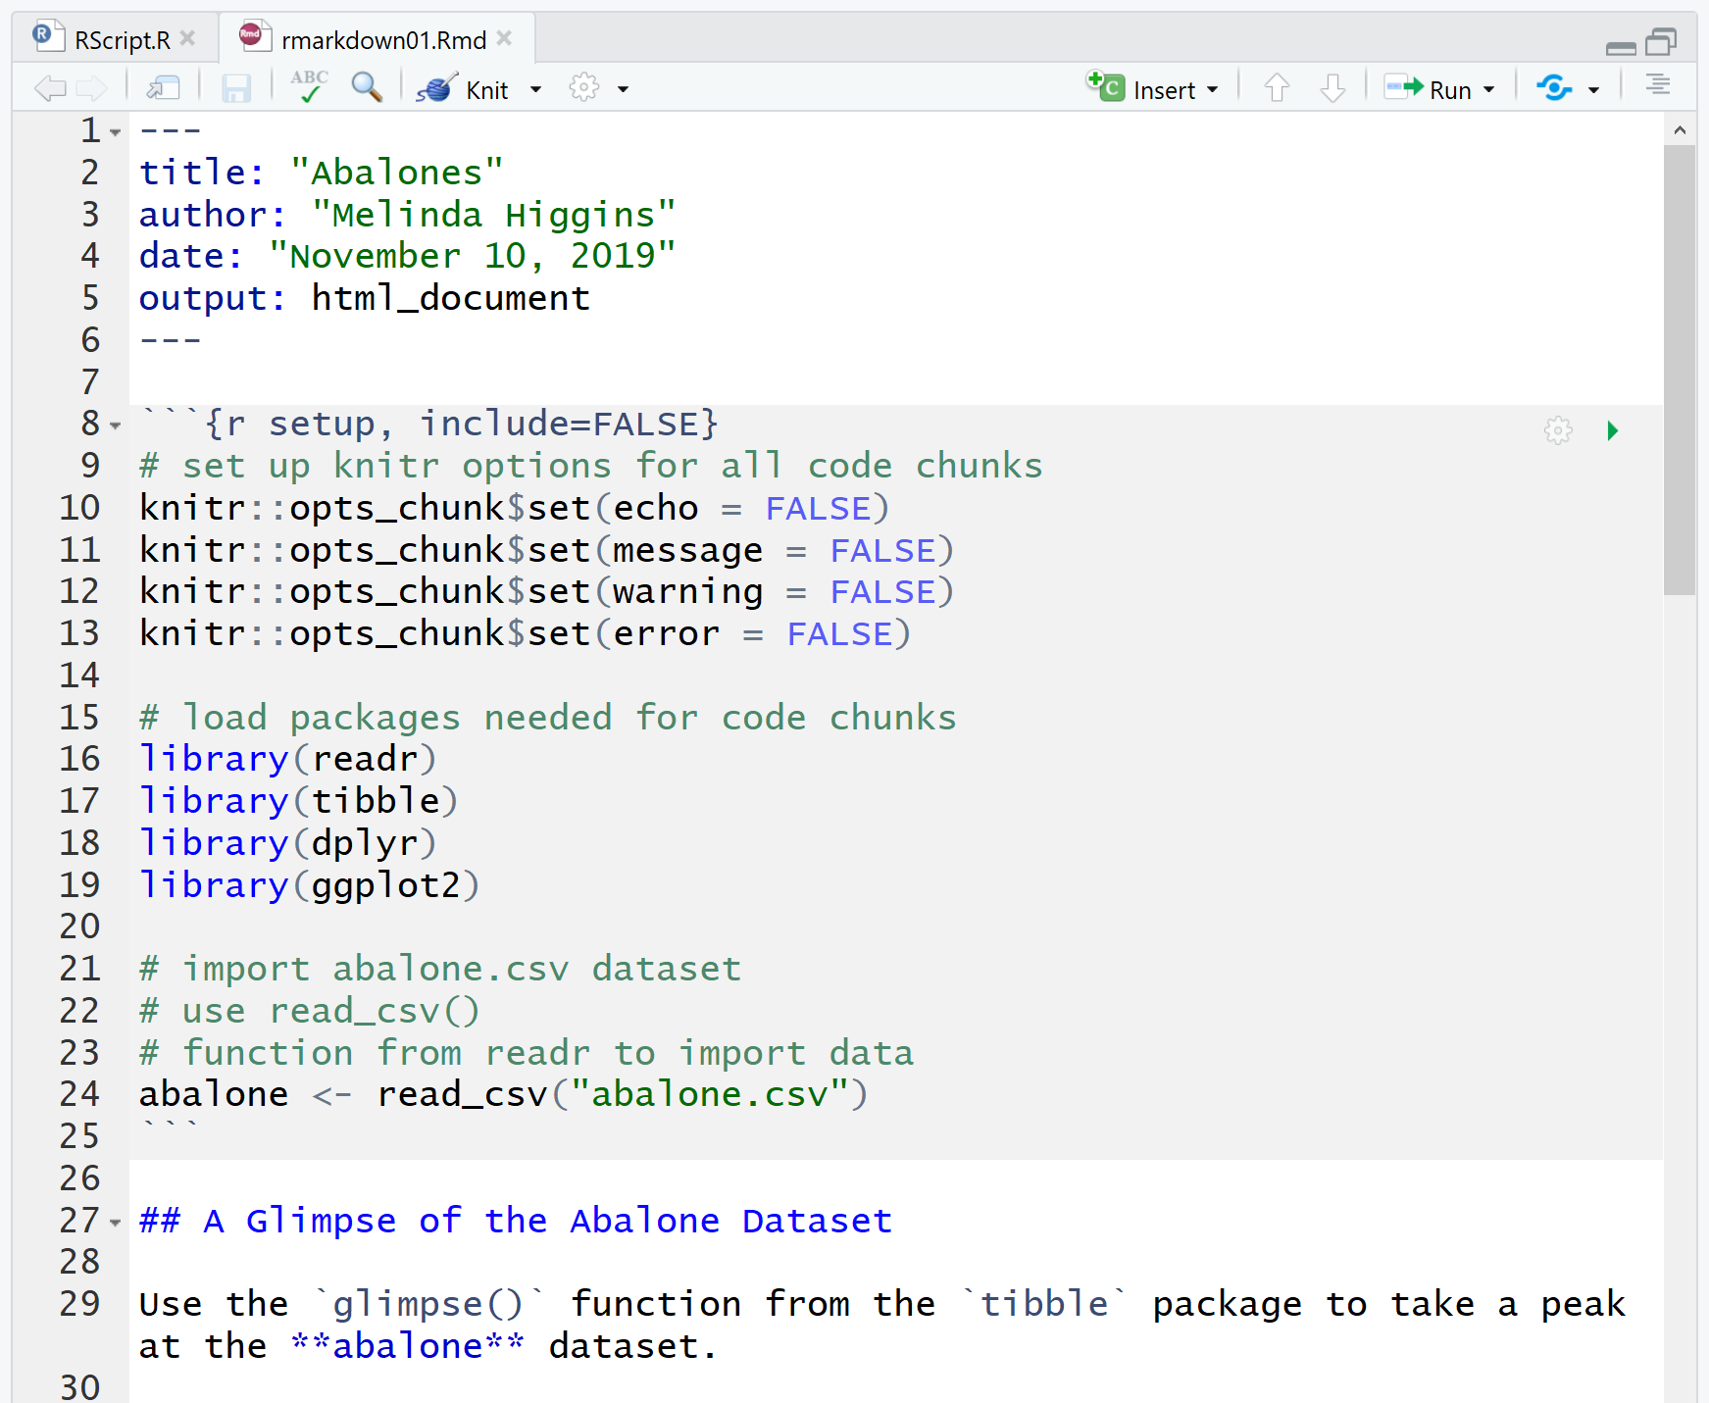
Rmarkdown
YAML
R CODE
CHUNK
Open rmarkdown01.rmd
“Marked” up text

Slide 8
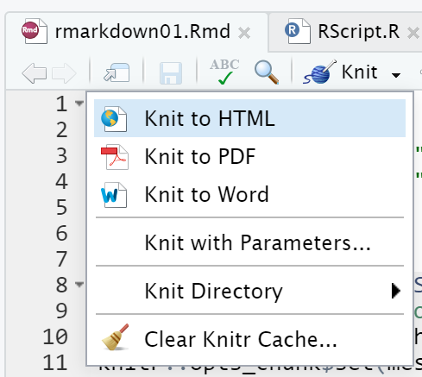
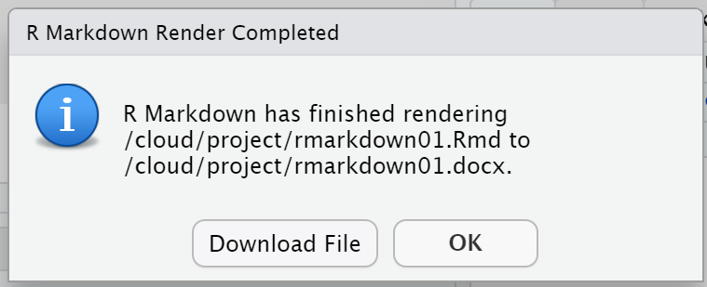
“KNIT” the document
Try all 3 options

Slide 9
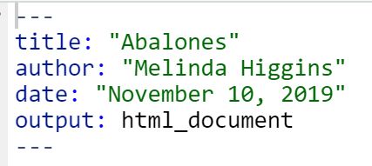
Edit yaml and re-knit document
Change author and date and re-knit document

Slide 10
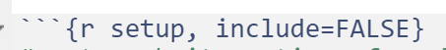
First r chunk
Begins with 3 backticks ```
Followed by {r} to indicate r code will follow
After r space type simple word to label the r chunk
After comma KNITR options can be specified
… add r code …
End with 3 backticks ``` to end r code section

Slide 11
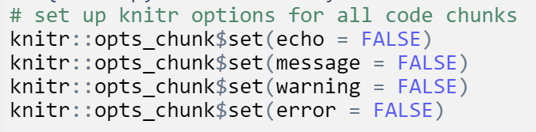
Knitr options
https://yihui.name/knitr/options/

Slide 12
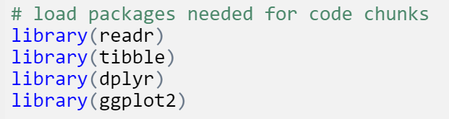
Load packages

Slide 13
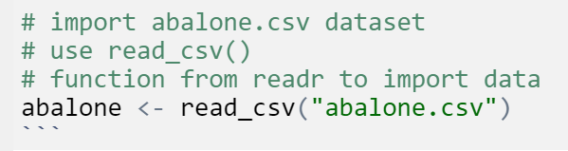
Add other code and end chunk

Slide 14
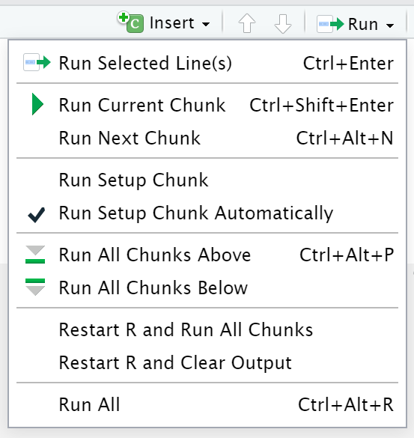
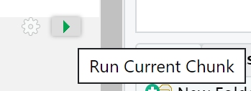
Run code inside rmarkdown

Slide 15
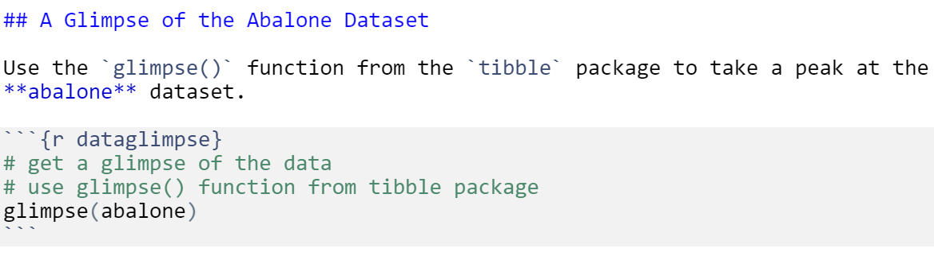
Add a section of document text
Marked up text
HEADER – Level 2
Next code chunk

Slide 16
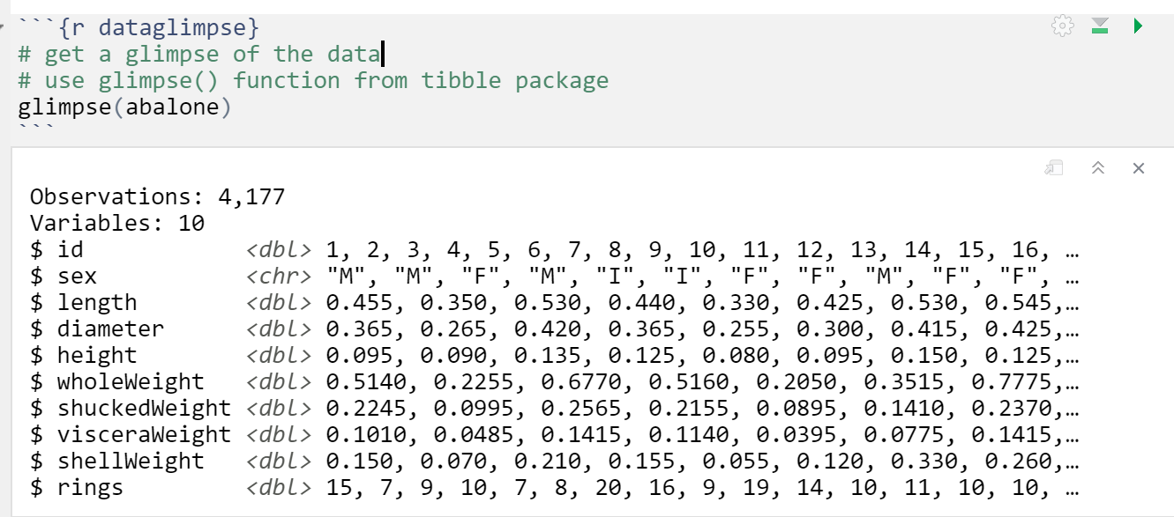
R chunk run interactively

Slide 17
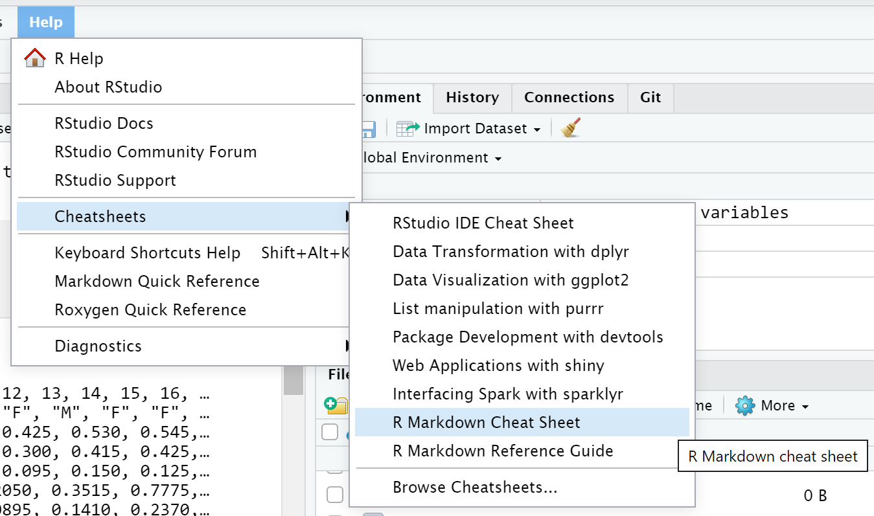
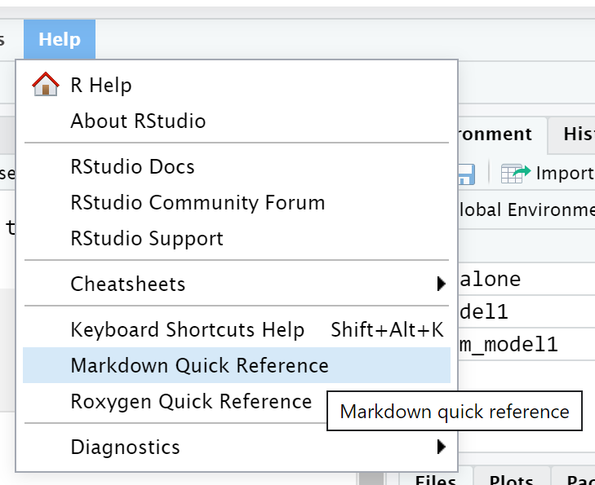
Rmarkdown help

Slide 18
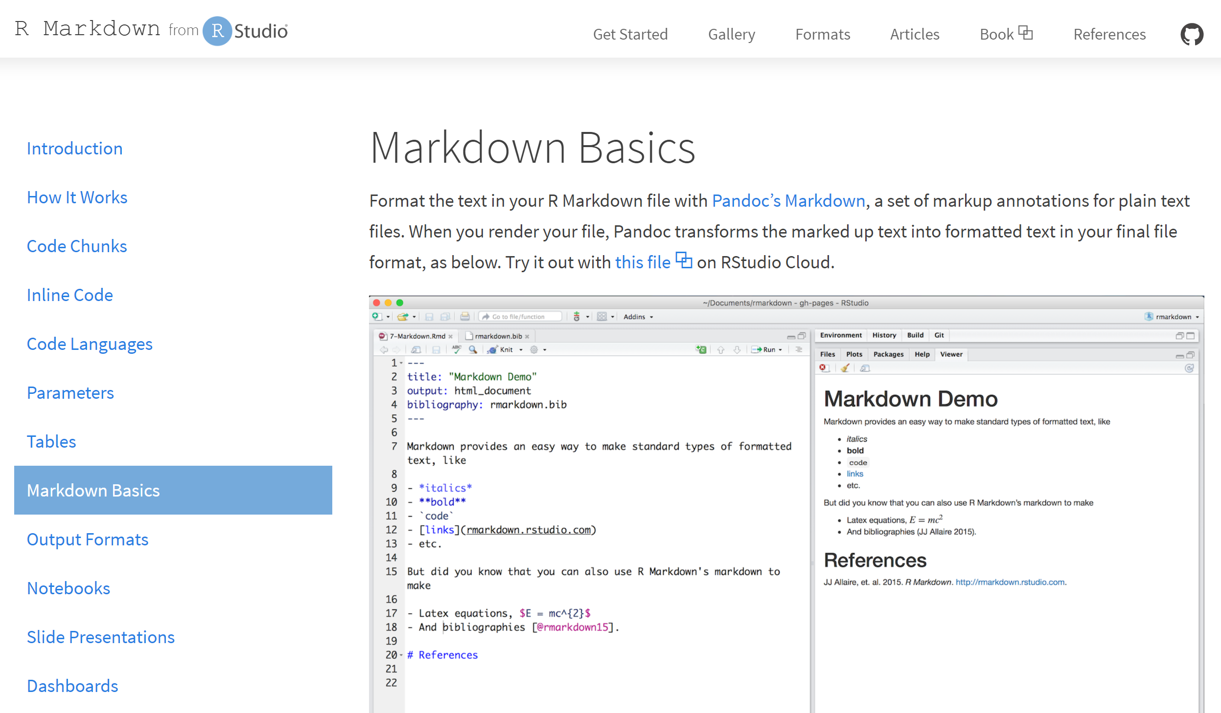
https://rmarkdown.rstudio.com/lesson-8.html

Slide 19
Run other chunks, Edit document, re-knit

Slide 21
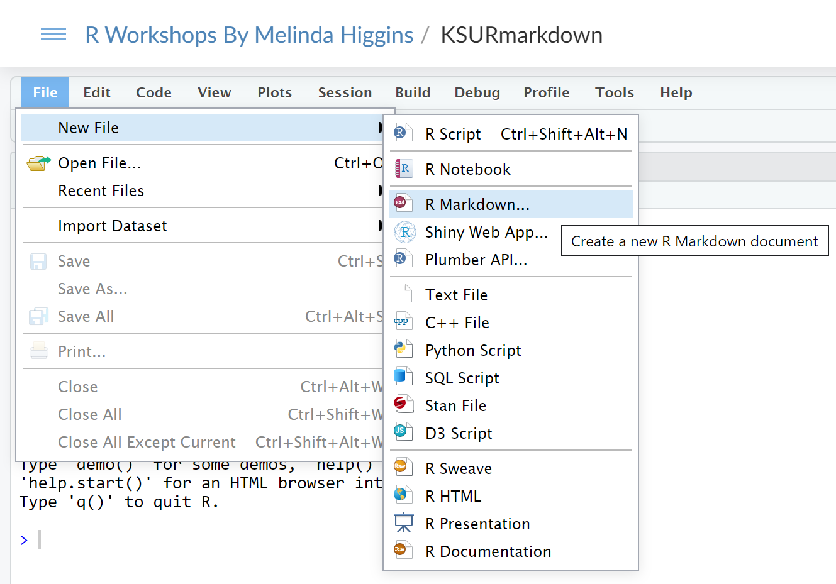
Rmarkdown options

Slide 22
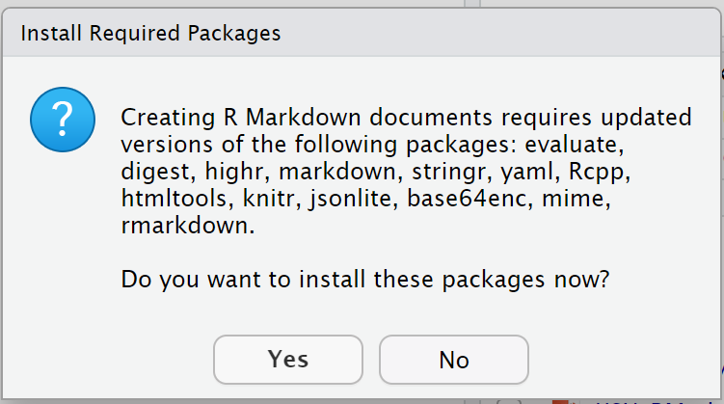
Rmarkdown options

Slide 23
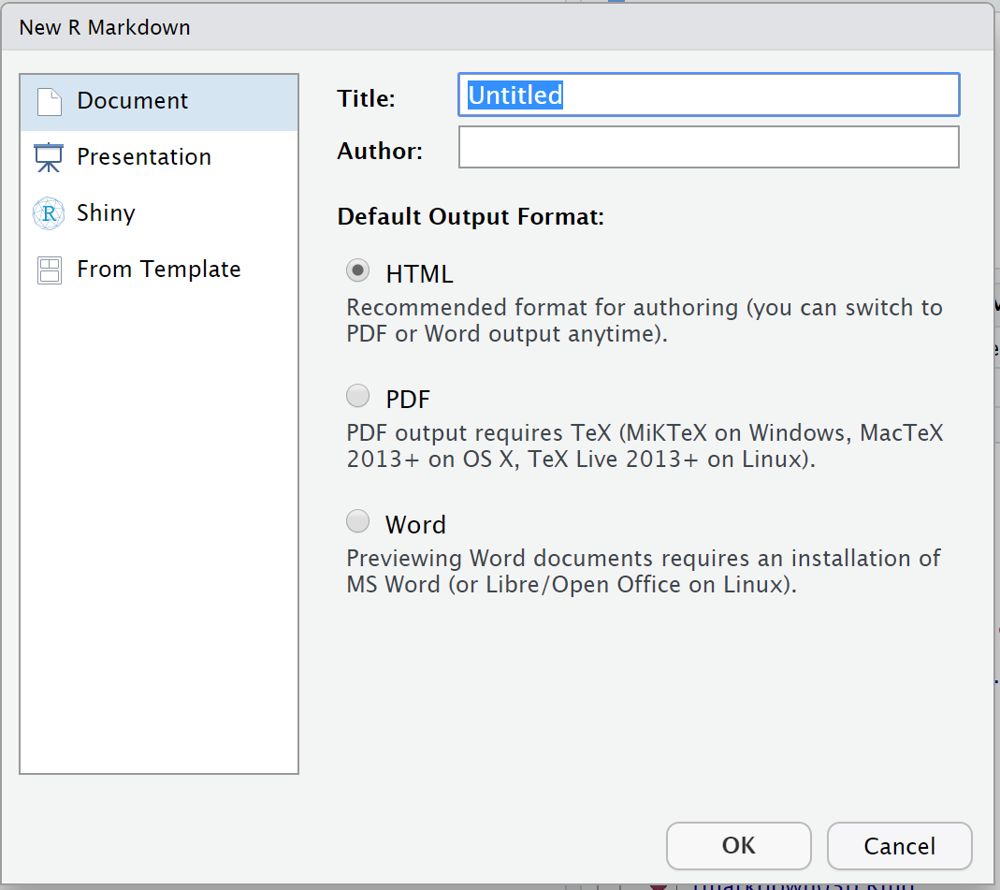
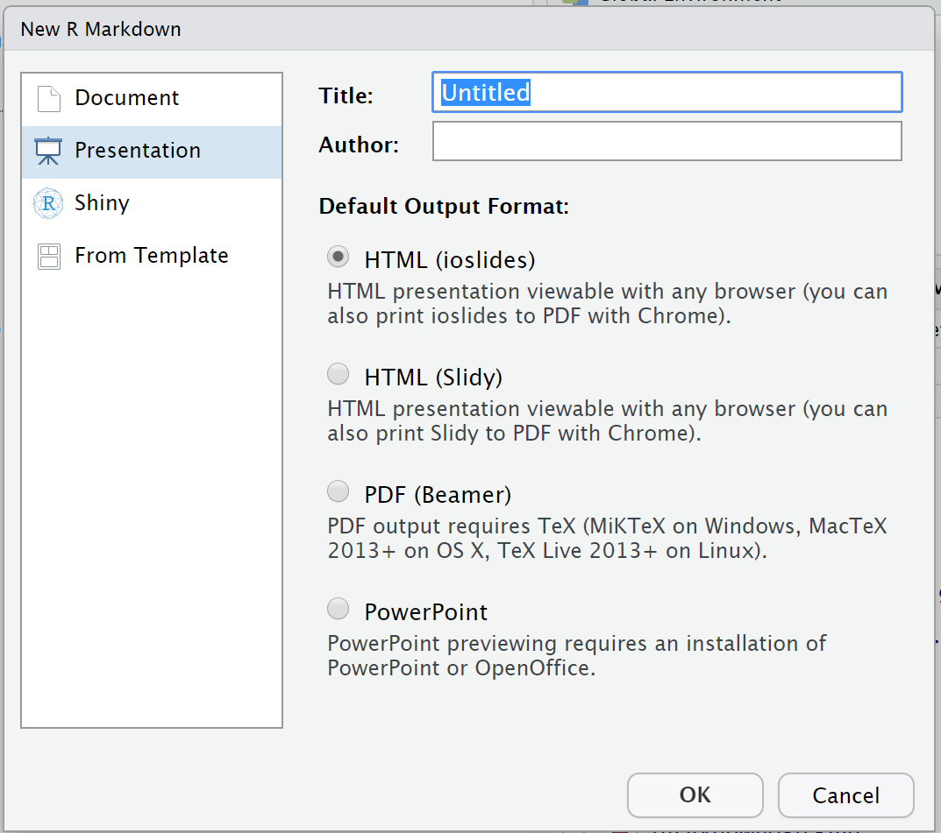
Rmarkdown options

Slide 24
Rmarkdown slide format
Open rmarkdown02.rmd
notice that YAML creates title slide
notice ## Header level 2 begins new slide

Slide 25
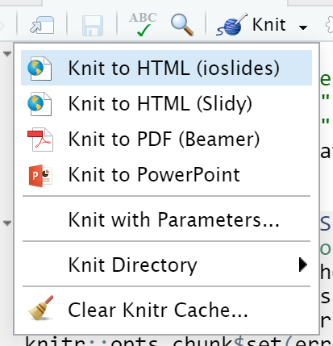
Rmarkdown – slide formats
Knit to HTML (ioslides)
Try other formats

Slide 26
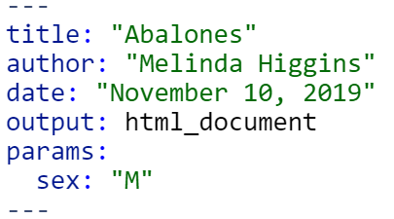
Rmarkdown with parameters
Open rmarkdown03a.rmd
Add parameters to document

Slide 27
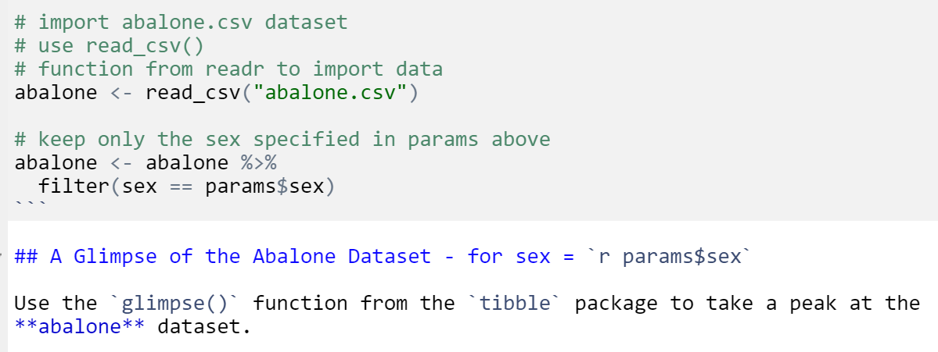
Use params in document

Slide 28
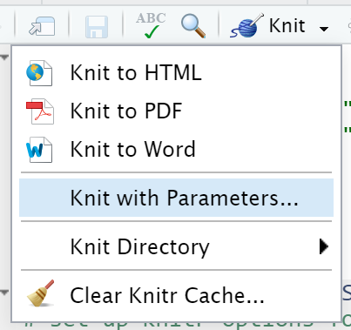
Knit with params
Knit with parameters

Slide 29
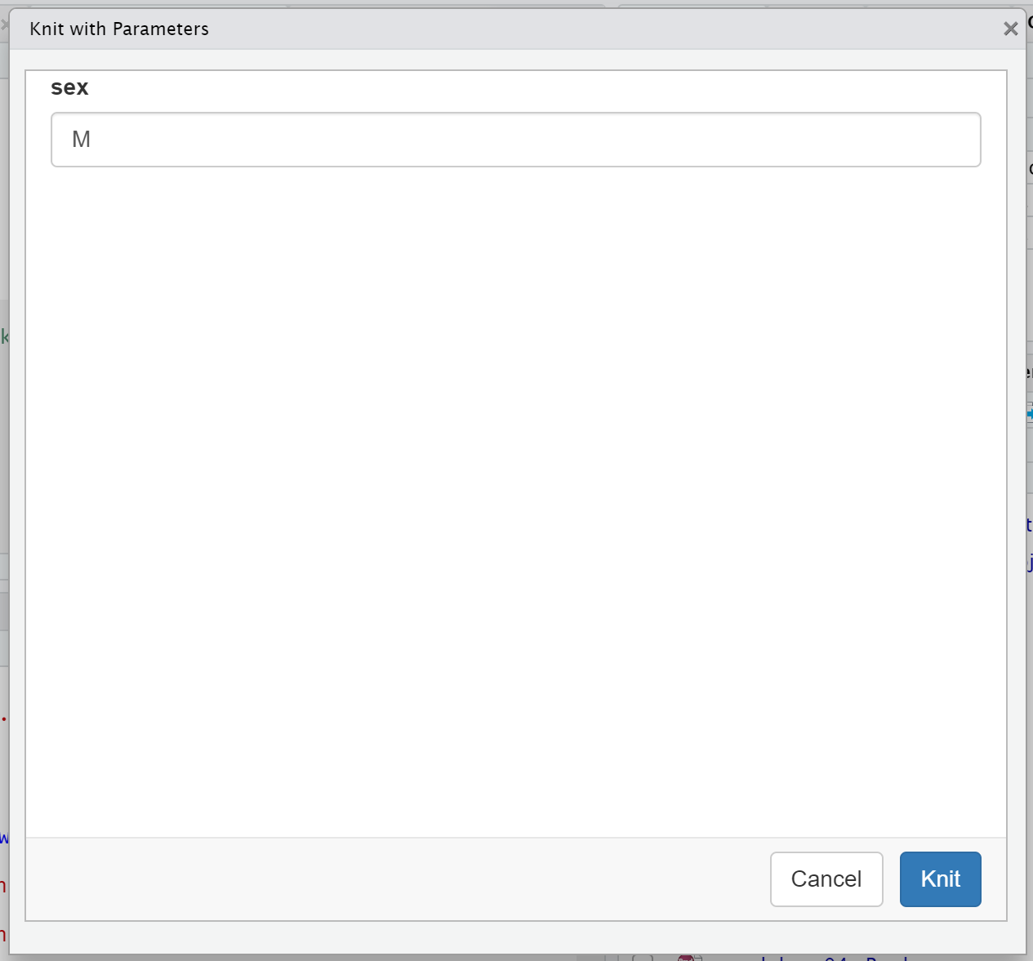
Type “M”, “F”, or “I”

Slide 30
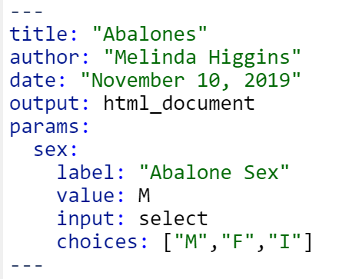
Rmarkdown with parameters – pick list
Open rmarkdown03b.rmd
YAML updated
create pull down box
“shiny” under-the-hood

Slide 31
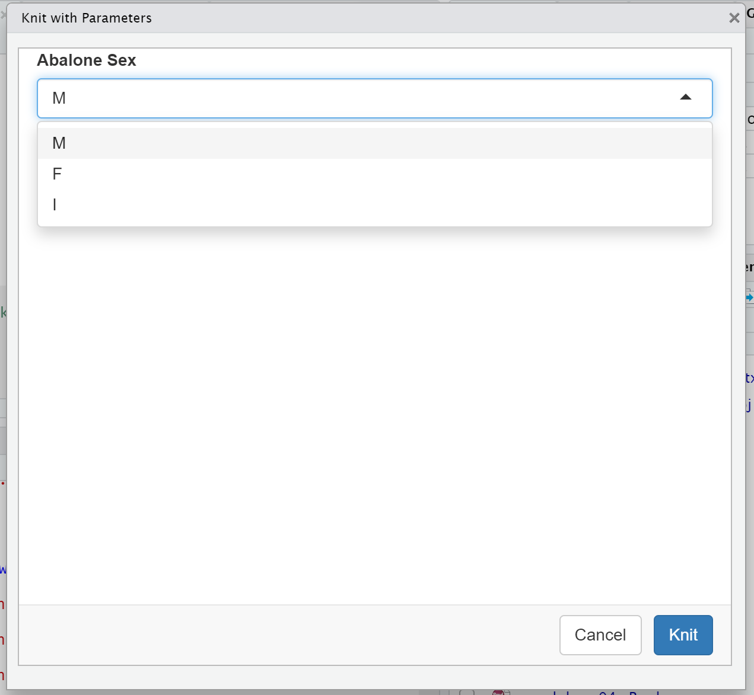
Knit with parameters
Pulldown list added
Interface created with shiny

Slide 32
Rmarkdown – other formats
https://rmarkdown.rstudio.com/formats.html
Dashboards
https://rmarkdown.rstudio.com/flexdashboard/index.html

Slide 33
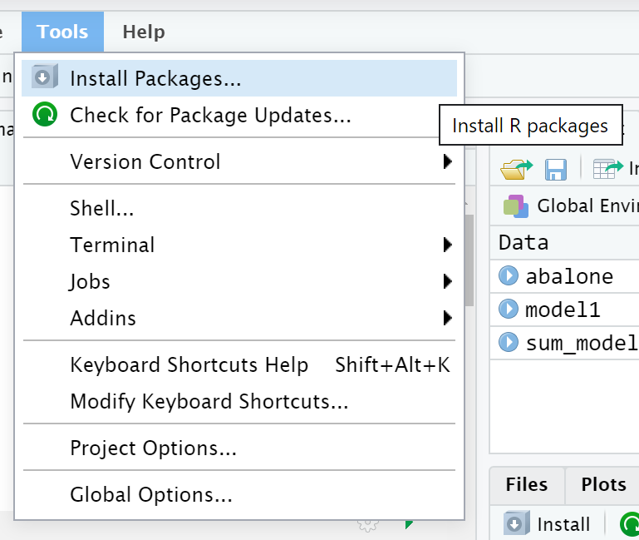
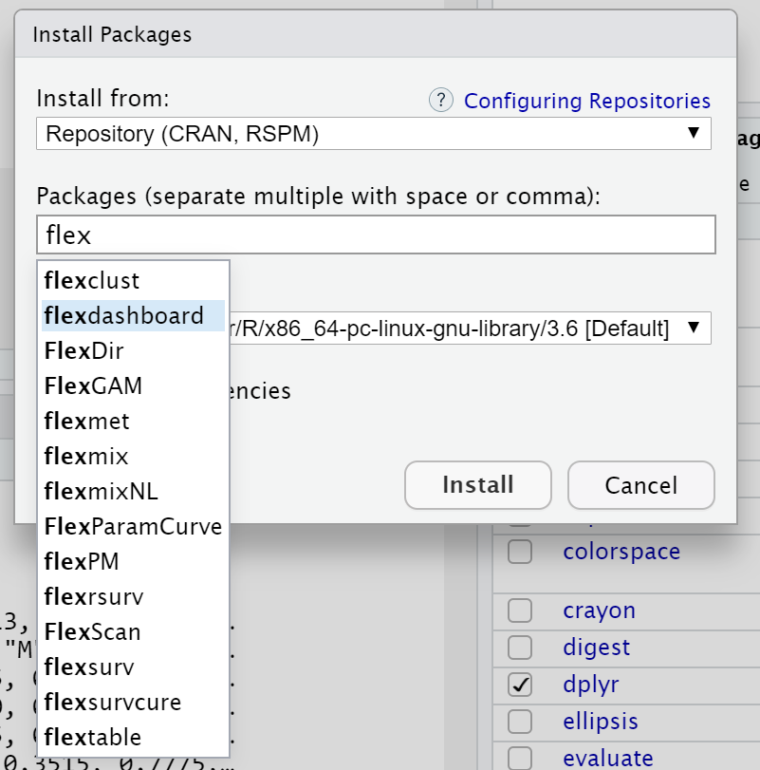
Flexdashboard – install package

Slide 34
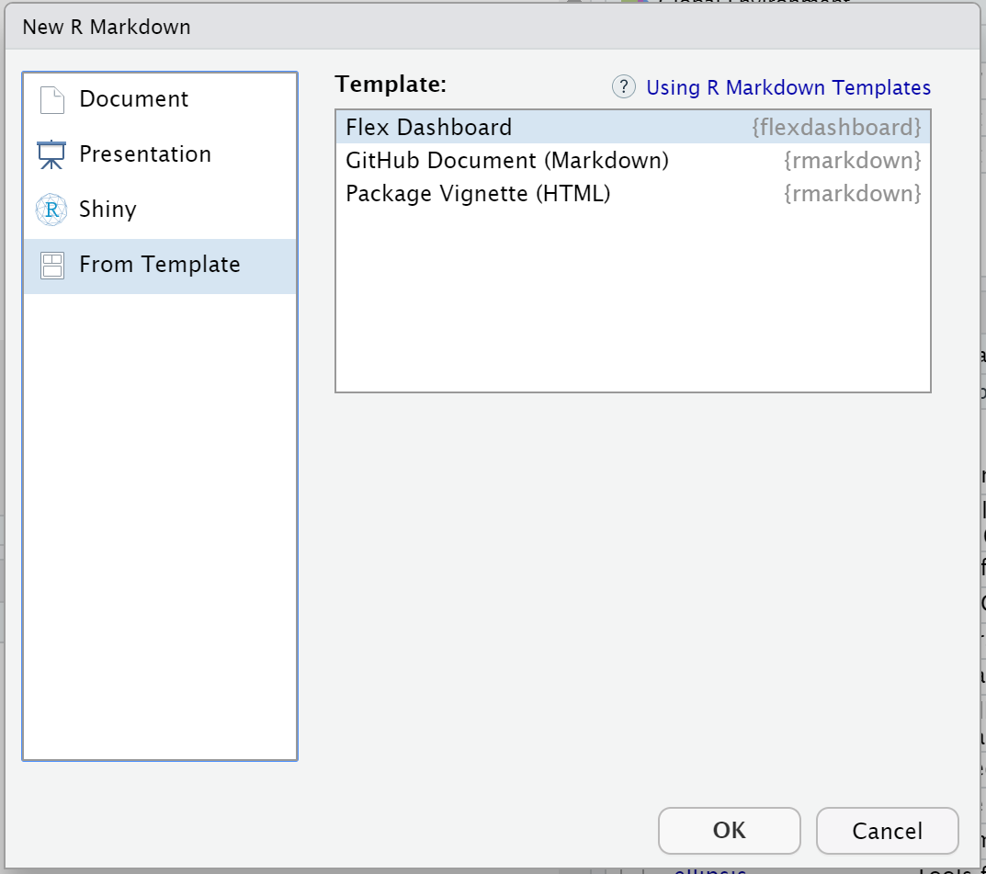
Flexdashboard template

Slide 35
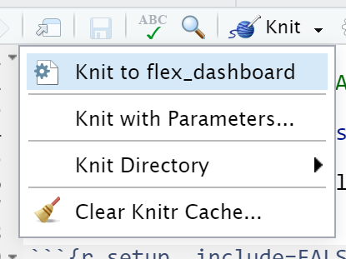
Explore dashboards
Open rmarkdown04a.rmd
knit to flex_dashboard
Open rmarkdown04b.rmd
knit to flex_dashboard

